Slide 1
Deep Learning-Based Sensor Fusion for 3D Object Detection in Autonomous Vehicles
Supervised By: Catherine Elias
Presented By: Abdelrahman Zidan

Slide 2
Outline
Radar Breakdown
Message Decoding
Radar Visualization
Filtration Attempts
What’s Next?

Slide 3
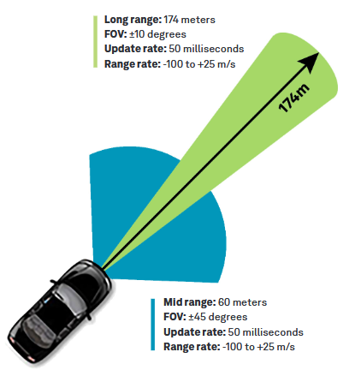
Delphi ESR 2.5
64 Tracks
8 Byte Messages
Range, Angle, Velocity

Slide 4
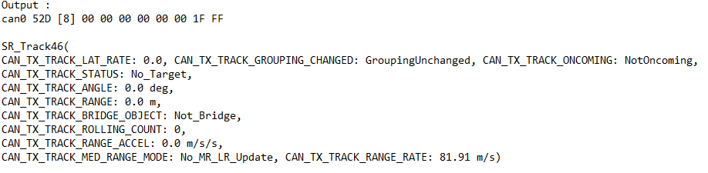
Message Decoding
Controller Area Network (CAN bus)
Database CAN File

Slide 5
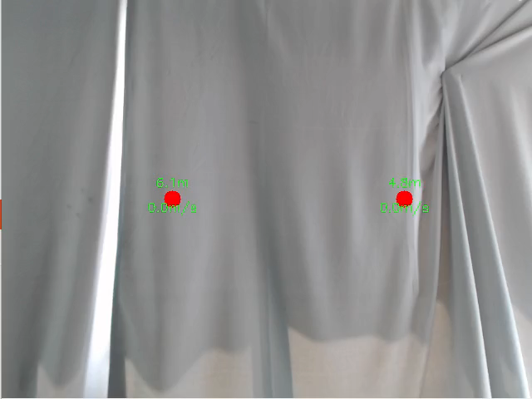
Radar Visualisation

Slide 6
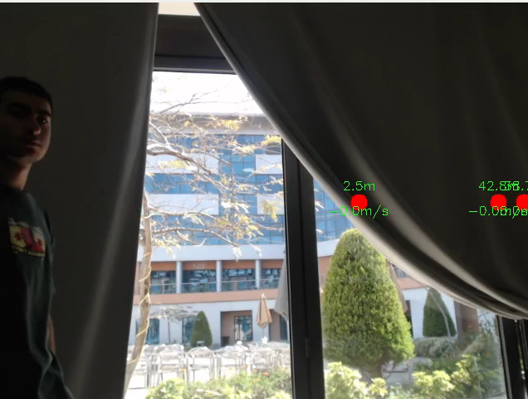
Radar Filtration
Kalman Filter
Current Issues?

Slide 7
What’s Next?
Finalize Filtration
Filter more features (range, velocity)
Continuous Filtration
1st Fusion Attempt

Slide 8
Thank You

